Slide 1
HP Laptop Billing with Discount and Taxes

Slide 2
HP Laptop Billing with Discount and Taxes
Introduction to HP Laptop Sales
Base Price and Tax Rates
Quantity-Based Discount Structure
Calculating Total Laptop Cost
Tax Computation Details
Final Billing Summary
Conclusion and Customer Appreciation

Slide 3

Introduction to HP Laptop Sales
Product Overview: HP Laptop priced at ₹50,000; a reliable computing device suitable for personal and professional use.
Presentation Purpose: Explain the billing process including pricing, taxes, and discounts applied on multiple laptop purchases.
Business Context: Transparent billing processes improve customer experience, fostering trust and facilitating bulk sales.

Slide 4
Base Price and Tax Rates
HP Laptop Base Price: Each HP laptop is priced at ₹50,000, forming the foundational cost for billing calculations.
SGST and CGST Rates: State (SGST) and Central (CGST) Goods and Services Taxes are both set at 10 percent each.
Tax Application Sequence: Taxes are added on the total laptop cost before any discounts to ensure accurate billing amounts.

Slide 5
Quantity-Based Discount Structure
Discount Tiers Explained: Discount rates escalate progressively: from 2% below 2 units up to 33% for 41 or more laptops.
Incentivizing Bulk Purchases: Higher purchase quantities qualify for larger discounts, motivating customers towards significant bulk buying.
Strategic Pricing Impact: Progressive discounting balances profitability and customer attraction through tiered, quantity-based pricing incentives.

Slide 6

Calculating Total Laptop Cost
Base Cost Calculation: Multiply required laptop quantity by base price (₹50,000) to determine initial total laptop cost.
Foundation for Billing: This total sets the basis for subsequent SGST, CGST, and discount computations applied in billing.
Importance in Pricing Logic: Accurate total cost calculation enables precise tax and discount applications ensuring customer billing transparency.

Slide 7
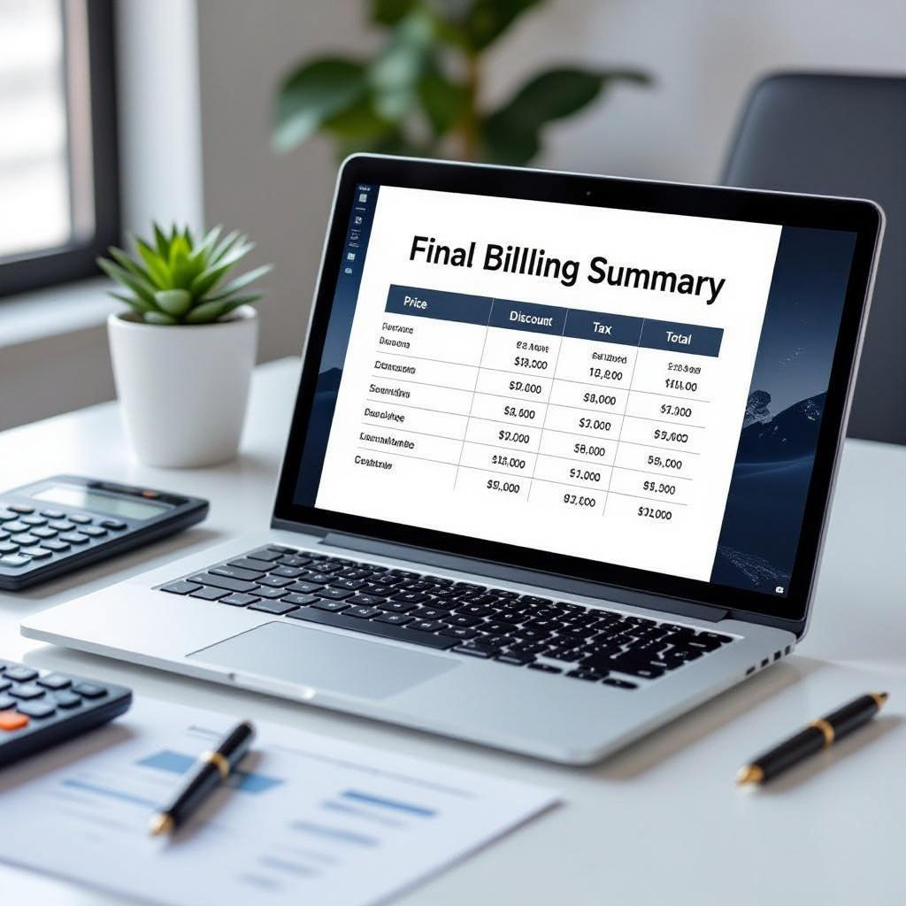
Final Billing Summary
Comprehensive Cost Breakdown: Total laptop cost, tax amounts, applied discount, and final payable amount summarized clearly for client transparency.
Example Calculation for 15 Units: For 15 laptops: base ₹750,000; SGST ₹75,000; CGST ₹75,000; 18% discount; total ₹765,000 payable.
Importance of Detailed Summary: This detailed billing report instills trust, reduces disputes, and aids accounting and customer understanding.

Slide 8
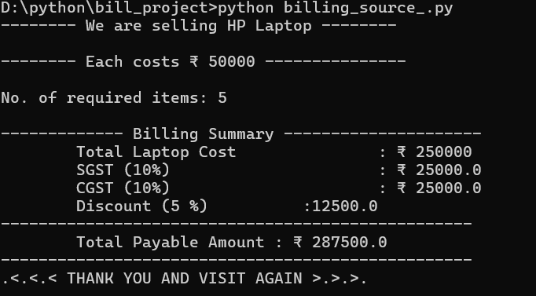
Simple output(billing):

Slide 9
Conclusion and Customer Appreciation
Customer Gratitude: Thank you for trusting our transparent billing system ensuring clear cost, tax, and discount calculations.
Transparency Drives Loyalty: Accurate, detailed billing fosters customer confidence and encourages repeat purchases and long-term partnerships.
Future Adaptability: Our system’s flexibility supports easy customization for diverse products enhancing customer satisfaction continuously.

Slide 10
THANK YOU

